Slide 1
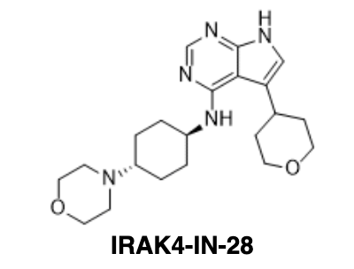
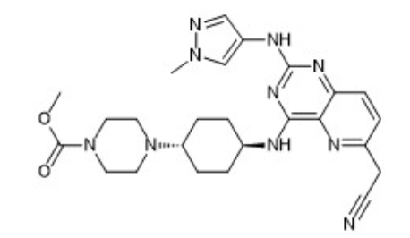
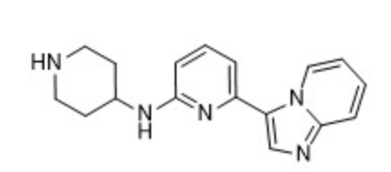
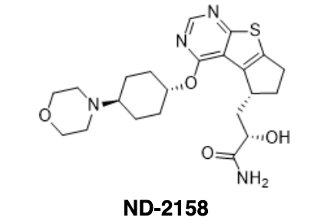
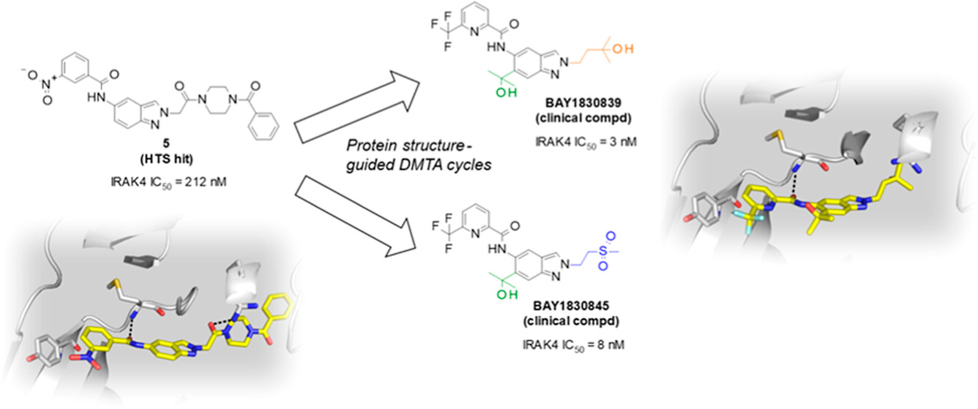
Scaffold Splitting for ML Training
First Generation of IRAK4 Inhibitors (with heterocyclic hinge binding moiety)
New Generation of IRAK4 Inhibitors (with amide hinge binding moiety)
New generation IRAK4 inhibitors bear little resemblance to first generation of IRAK4 inhibitors, yet have similar interaction profile

Slide 2
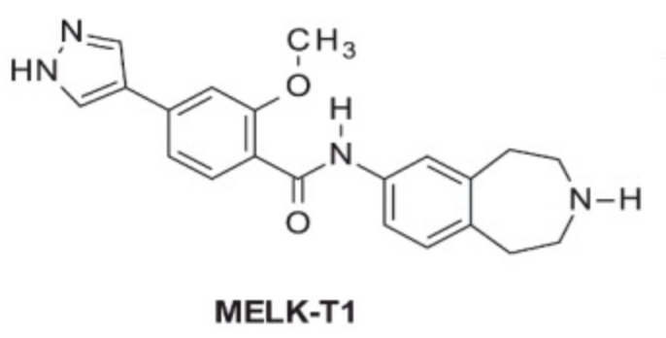
A Small Amide Library to Generate Kinome Data for pKi ML Model Training
Biaryl to explore backpocket
Hinge binding
Solvent front group
500 library compounds x 400 kinases = 200,000 data points (training set)
Kinase inhibitors with pyridine/pyrimidine/quinoline scaffold (validation set)
Clinical trial compounds with high potency and good selectivity (test set)
Cross validation with first generation of inhibitors in training machine learning models
The ML model may lead to more novel kinase inhibitors:
The Tao produced One; One produced Two; Two produced Three; Three produced All things. 道生一，一生二，二生三，三生万物。

